Slide 1


Customer Satisfaction Study
VS
Rashmi Sarode
Riddhi Patel
Sheri Belle

Slide 2
Agenda
Objective
Questionnaire Design
Sampling Plan
Survey Administration/Data collection
Analysis and Findings
Conclusions/Recommendations

Slide 3
Objective
Objective: Conduct a marketing research study of customer satisfaction for retailers Walmart & Target
by assessing customer satisfaction ratings of two common retailers that are viewed by consumers as more or less substitutes

Slide 4
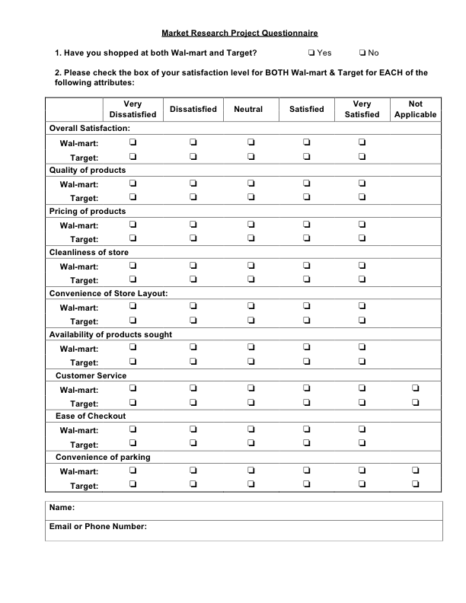
Questionnaire design for Walmart Vs Target
Attributes for Analysis:
Overall Satisfaction
Product quality
Product price
Cleanliness of Store
Convenience of Store layout
Product Availability
Customer Service
Ease of Check Out
Parking Convenience

Slide 5
Sampling Plan and Data Collection
Convenience Sampling
60 Valid Responses
The sample consists of:
regular Walmart & Target shoppers
off-campus graduate students near New Brunswick, NJ area
friends of team members living in Woodbridge , Edison and Livingston 2-5 miles away from nearest target & Walmart.

Slide 6
Analysis and Findings

Slide 7





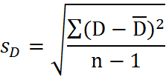
Hypothesis test of mean scores for overall satisfaction of Walmart and Target
Hypothesis : = 0.4 n = 60
Test statistic: = (0.4-0)/0.168 = 2.375
Standard Error: = 1.305/sqrt(60) = 0.168
Standard Deviation: = sqrt(100.4/59) = 1.304
Decision:
Reject H₀ since 2.375 > 1.961 (Z_{alpha/2 =} Z_{0.475} = 1.961 )
There is a difference in the overall satisfaction for Walmart and Target. Satisfaction for Target is slightly higher

Slide 8
Hypothesis test of mean scores for individual attributes of Walmart and Target
Product Quality:
Hypothesis : mean of difference = 0.467 n = 60
Standard Deviation: 1.171
Standard Error: 0.151
T Statistic: 3.086
Decision : Reject the H₀ because the t statistic is greater than the Z_{0.475.} Target is preferred.
Product Price:
Hypothesis : mean of difference = -0.767 n = 60
Standard Deviation: 1.198
Standard Error: 0.154
T Statistic: -4.955
Decision : Reject the H₀ because the t statistic is less than the –(Z_{0.475}) Walmart is preferred.

Slide 9
Cleanliness of Store :
Hypothesis : mean of difference = 1.017 n = 60
Standard Deviation: 1.282
Standard Error: 0.165
T Statistic: 6.142
Decision : Reject the H₀ because the t statistic is greater than the Z_{0.475.} Target is preferred.
Convenience of Store Layout :
Hypothesis : mean of difference = 0.383 n = 60
Standard Deviation: 1.263
Standard Error: 0.163
T Statistic: 2.35
Decision : Reject the H₀ because the t statistic is greater than the Z_{0.475}. Target is slightly preferred.

Slide 10
Product Availability:
Hypothesis : mean of difference = 0.283 n = 60
Standard Deviation: 1.328
Standard Error: 0.171
T Statistic: 1.652
Decision : Fail to reject the H₀ because the t statistic is less than the Z_{0.475.} Little or no difference in preference for Walmart or Target.
Customer Service:
Hypothesis : mean of difference = 0.717 n = 60
Standard Deviation: 1.290
Standard Error: 0.167
T Statistic: 4.303
Decision : Reject the H₀ because the t statistic is greater than the Z_{0.475} . Target is preferred.

Slide 11
Ease of Checkout:
Hypothesis : mean of difference = 0.133 n = 60
Standard Deviation: 1.213
Standard Error: 0.156
T Statistic: 0.850
Decision : Fail to reject the H₀ because the t statistic is less than the Z_{0.475} . Little or no difference in preference for Walmart or Target.
Parking Convenience:
Hypothesis : mean of difference = 0.117 n = 60
Standard Deviation: 0.783
Standard Error: 0.101
T Statistic: 1.153
Decision : Fail to reject the H₀ because the t statistic is less than the Z_{0.475}. Little or no difference in preference for Walmart or Target.

Slide 12
Walmart Importance Performance Chart
Importance
(correlation to overall satisfaction)
Performance
(Mean of attribute rating)

Slide 13
Target Importance Performance Chart
Importance
(correlation to overall satisfaction)
Performance
(Mean of attribute rating)

Slide 14
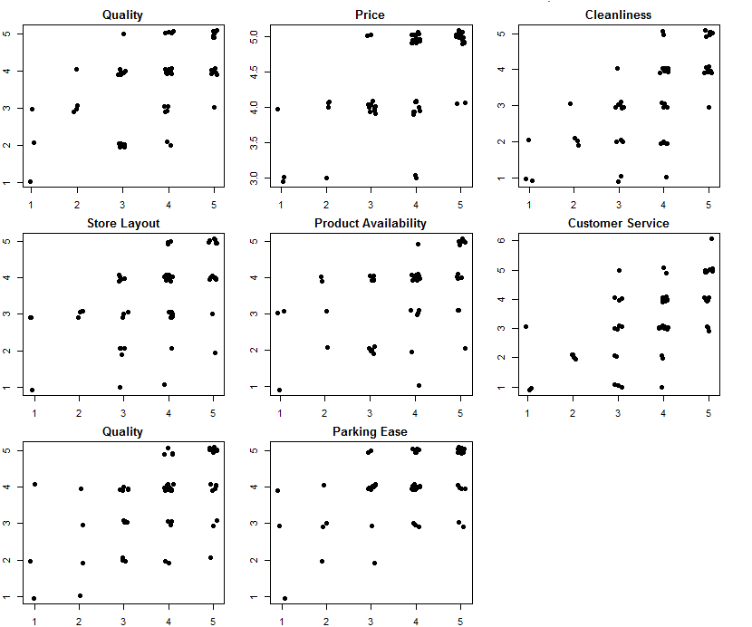
WALMART :
Scatter Plot of
Satisfaction (Y axis) Vs Attributes

Slide 15
Correlation matrix for Walmart
Correlations
 |  | satisfaction | quality | price | clean | layout | avail | custService | checkOut | parking
satisfaction | Pearson Correlation | 1 | .582** | .628** | .693** | .516** | .478** | .629** | .525** | .533**
 | Sig. (2-tailed) |  | .000 | .000 | .000 | .000 | .000 | .000 | .000 | .000
 | N | 60 | 60 | 60 | 60 | 60 | 60 | 60 | 60 | 60
quality | Pearson Correlation | .582** | 1 | .386** | .432** | .410** | .421** | .397** | .273* | .156
 | Sig. (2-tailed) | .000 |  | .002 | .001 | .001 | .001 | .002 | .035 | .233
 | N | 60 | 60 | 60 | 60 | 60 | 60 | 60 | 60 | 60
price | Pearson Correlation | .628** | .386** | 1 | .248 | .417** | .379** | .258* | .420** | .204
 | Sig. (2-tailed) | .000 | .002 |  | .056 | .001 | .003 | .046 | .001 | .117
 | N | 60 | 60 | 60 | 60 | 60 | 60 | 60 | 60 | 60
clean | Pearson Correlation | .693** | .432** | .248 | 1 | .580** | .447** | .483** | .482** | .593**
 | Sig. (2-tailed) | .000 | .001 | .056 |  | .000 | .000 | .000 | .000 | .000
 | N | 60 | 60 | 60 | 60 | 60 | 60 | 60 | 60 | 60
layout | Pearson Correlation | .516** | .410** | .417** | .580** | 1 | .651** | .321* | .478** | .442**
 | Sig. (2-tailed) | .000 | .001 | .001 | .000 |  | .000 | .012 | .000 | .000
 | N | 60 | 60 | 60 | 60 | 60 | 60 | 60 | 60 | 60
avail | Pearson Correlation | .478** | .421** | .379** | .447** | .651** | 1 | .457** | .314* | .163
 | Sig. (2-tailed) | .000 | .001 | .003 | .000 | .000 |  | .000 | .015 | .213
 | N | 60 | 60 | 60 | 60 | 60 | 60 | 60 | 60 | 60
custService | Pearson Correlation | .629** | .397** | .258* | .483** | .321* | .457** | 1 | .465** | .402**
 | Sig. (2-tailed) | .000 | .002 | .046 | .000 | .012 | .000 |  | .000 | .001
 | N | 60 | 60 | 60 | 60 | 60 | 60 | 60 | 60 | 60
checkOut | Pearson Correlation | .525** | .273* | .420** | .482** | .478** | .314* | .465** | 1 | .530**
 | Sig. (2-tailed) | .000 | .035 | .001 | .000 | .000 | .015 | .000 |  | .000
 | N | 60 | 60 | 60 | 60 | 60 | 60 | 60 | 60 | 60
parking | Pearson Correlation | .533** | .156 | .204 | .593** | .442** | .163 | .402** | .530** | 1
 | Sig. (2-tailed) | .000 | .233 | .117 | .000 | .000 | .213 | .001 | .000
 | N | 60 | 60 | 60 | 60 | 60 | 60 | 60 | 60 | 60
**. Correlation is significant at the 0.01 level (2-tailed).
*. Correlation is significant at the 0.05 level (2-tailed).

Slide 16
Walmart Customer satisfaction model
Regression Statistics
Multiple R | 0.895
R Square | 0.802
Adjusted R Square | 0.771
Standard Error | 0.517
Observations | 60
ANOVA
 | df | SS | MS | F | Significance F
Regression | 8 | 55.106 | 6.888 | 25.778 | 2.20585E-15
Residual | 51 | 13.628 | 0.267
Total | 59 | 68.733
 | Coefficients | Standard Error | t Stat | P-value | Lower 95% | Upper 95%
Intercept | -2.210 | 0.545 | -4.055 | 0.000 | -3.305 | -1.116
quality | 0.191 | 0.081 | 2.353 | 0.023 | 0.028 | 0.354
price | 0.701 | 0.125 | 5.588 | 0.000 | 0.449 | 0.953
c lean | 0.323 | 0.086 | 3.759 | 0.000 | 0.150 | 0.495
layout | -0.077 | 0.104 | -0.739 | 0.464 | -0.285 | 0.132
avail | 0.004 | 0.099 | 0.035 | 0.972 | -0.196 | 0.203
custService | 0.220 | 0.072 | 3.052 | 0.004 | 0.075 | 0.365
checkOut | -0.040 | 0.085 | -0.475 | 0.637 | -0.211 | 0.130
parking | 0.195 | 0.108 | 1.808 | 0.076 | -0.022 | 0.412

Slide 17
Walmart Customer Satisfaction Model
The model for Walmart is:
Overall Satisfaction = 0.190 * quality + 0.701 * price +
0.323 * clean – 0.077 *layout +
0.220 * custService + 0.195 * parking – 2.210

Slide 18
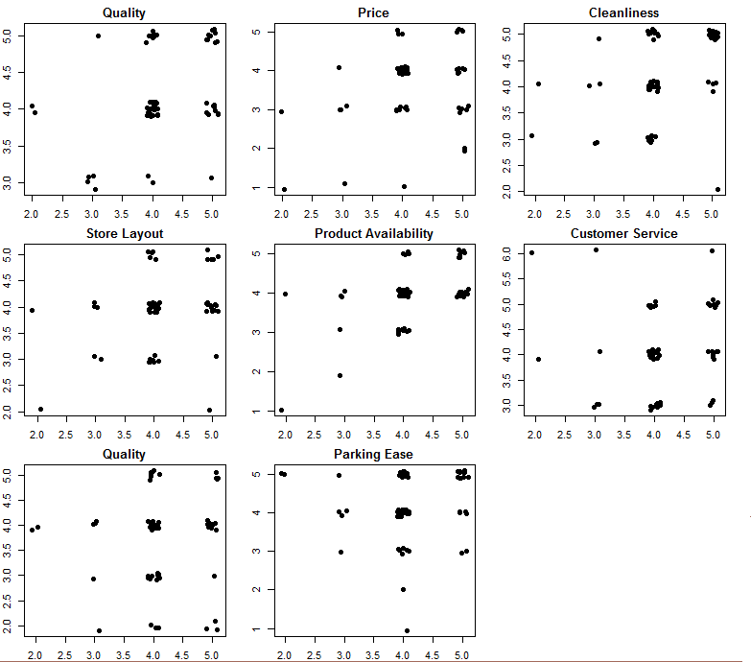
TARGET:
Scatter Plot of
Satisfaction (Y axis) Vs Attributes

Slide 19
Correlation Matrix for Target
Correlations
 |  | satisfaction | quality | price | clean | layout | avail | custService | checkOut | parking
satisfaction | Pearson Correlation | 1 | .347** | .341** | .382** | .300* | .521** | .067 | .087 | .108
 | Sig. (2-tailed) |  | .007 | .008 | .003 | .020 | .000 | .610 | .510 | .413
 | N | 60 | 60 | 60 | 60 | 60 | 60 | 60 | 60 | 60
quality | Pearson Correlation | .347** | 1 | .083 | .466** | .270* | .170 | .174 | -.013 | .210
 | Sig. (2-tailed) | .007 |  | .530 | .000 | .037 | .194 | .183 | .922 | .107
 | N | 60 | 60 | 60 | 60 | 60 | 60 | 60 | 60 | 60
price | Pearson Correlation | .341** | .083 | 1 | .240 | .163 | .326* | -.079 | -.138 | .066
 | Sig. (2-tailed) | .008 | .530 |  | .064 | .214 | .011 | .546 | .295 | .617
 | N | 60 | 60 | 60 | 60 | 60 | 60 | 60 | 60 | 60
clean | Pearson Correlation | .382** | .466** | .240 | 1 | .228 | .377** | .214 | .084 | .200
 | Sig. (2-tailed) | .003 | .000 | .064 |  | .079 | .003 | .101 | .521 | .126
 | N | 60 | 60 | 60 | 60 | 60 | 60 | 60 | 60 | 60
layout | Pearson Correlation | .300* | .270* | .163 | .228 | 1 | .440** | .188 | .371** | .028
 | Sig. (2-tailed) | .020 | .037 | .214 | .079 |  | .000 | .150 | .004 | .834
 | N | 60 | 60 | 60 | 60 | 60 | 60 | 60 | 60 | 60
avail | Pearson Correlation | .521** | .170 | .326* | .377** | .440** | 1 | -.075 | .125 | .071
 | Sig. (2-tailed) | .000 | .194 | .011 | .003 | .000 |  | .571 | .341 | .588
 | N | 60 | 60 | 60 | 60 | 60 | 60 | 60 | 60 | 60
custService | Pearson Correlation | .067 | .174 | -.079 | .214 | .188 | -.075 | 1 | .567** | .310*
 | Sig. (2-tailed) | .610 | .183 | .546 | .101 | .150 | .571 |  | .000 | .016
 | N | 60 | 60 | 60 | 60 | 60 | 60 | 60 | 60 | 60
checkOut | Pearson Correlation | .087 | -.013 | -.138 | .084 | .371** | .125 | .567** | 1 | .272*
 | Sig. (2-tailed) | .510 | .922 | .295 | .521 | .004 | .341 | .000 |  | .036
 | N | 60 | 60 | 60 | 60 | 60 | 60 | 60 | 60 | 60
parking | Pearson Correlation | .108 | .210 | .066 | .200 | .028 | .071 | .310* | .272* | 1
 | Sig. (2-tailed) | .413 | .107 | .617 | .126 | .834 | .588 | .016 | .036
 | N | 60 | 60 | 60 | 60 | 60 | 60 | 60 | 60 | 60
**. Correlation is significant at the 0.01 level (2-tailed).
*. Correlation is significant at the 0.05 level (2-tailed).

Slide 20
Target Customer Satisfaction Model
Regression Statistics
Multiple R | 0.6165
R Square | 0.3801
Adjusted R Square | 0.2828
Standard Error | 0.6072
Observations | 60
ANOVA
 | df | SS | MS | F | Significance F
Regression | 8 | 11.528 | 1.441 | 3.908 | 0.001
Residual | 51 | 18.805 | 0.369
Total | 59 | 30.333
 | Coefficients | Standard Error | t Stat | P-value | Lower 95% | Upper 95%
Intercept | 0.599 | 0.774 | 0.774 | 0.443 | -0.955 | 2.153
quality | 0.264 | 0.152 | 1.733 | 0.089 | -0.042 | 0.570
price | 0.144 | 0.093 | 1.543 | 0.129 | -0.043 | 0.331
clean | 0.070 | 0.128 | 0.551 | 0.584 | -0.186 | 0.326
layout | -0.007 | 0.143 | -0.049 | 0.961 | -0.294 | 0.280
avail | 0.373 | 0.131 | 2.839 | 0.006 | 0.109 | 0.637
custService | 0.031 | 0.127 | 0.246 | 0.807 | -0.224 | 0.286
checkOut | 0.038 | 0.121 | 0.312 | 0.756 | -0.204 | 0.280
parking | -0.016 | 0.099 | -0.166 | 0.869 | -0.216 | 0.183

Slide 21
Target Customer Satisfaction Model
The model for Target is:
Overall satisfaction = 0.373 * avail

Slide 22
Target Model post AIC Stepwise - Algorithm
Regression Statistics
Multiple R | 0.609
R Square | 0.370
Adjusted R Square | 0.337
Standard Error | 0.584
Observations | 60
ANOVA
 | df | SS | MS | F | Significance F
Regression | 3 | 11.237 | 3.746 | 10.985 | 8.93388E-06
Residual | 56 | 19.096 | 0.341
Total | 59 | 30.333
 | Coefficients | Standard Error | t Stat | P-value | Lower 95% | Upper 95%
Intercept | 0.843 | 0.625 | 1.350 | 0.183 | -0.409 | 2.095
quality | 0.300 | 0.124 | 2.426 | 0.019 | 0.052 | 0.548
price | 0.141 | 0.086 | 1.637 | 0.107 | -0.031 | 0.313
avail | 0.395 | 0.108 | 3.673 | 0.001 | 0.180 | 0.611
Overall satisfaction = 0.395 * avail +
0.30 * quality

Slide 23
Correlation for Walmart and Target Combined
Correlations
 |  | satisfaction | quality | price | clean | layout | avail | custService | checkOut | parking
satisfaction | Pearson Correlation | 1 | .541** | .305** | .619** | .475** | .508** | .493** | .370** | .363**
 | Sig. (2-tailed) |  | .000 | .001 | .000 | .000 | .000 | .000 | .000 | .000
 | N | 120 | 120 | 120 | 120 | 120 | 120 | 120 | 120 | 120
quality | Pearson Correlation | .541** | 1 | .078 | .500** | .405** | .367** | .390** | .185* | .183*
 | Sig. (2-tailed) | .000 |  | .400 | .000 | .000 | .000 | .000 | .043 | .046
 | N | 120 | 120 | 120 | 120 | 120 | 120 | 120 | 120 | 120
price | Pearson Correlation | .305** | .078 | 1 | -.017 | .147 | .228* | -.067 | .069 | .080
 | Sig. (2-tailed) | .001 | .400 |  | .857 | .109 | .012 | .469 | .456 | .387
 | N | 120 | 120 | 120 | 120 | 120 | 120 | 120 | 120 | 120
clean | Pearson Correlation | .619** | .500** | -.017 | 1 | .509** | .444** | .487** | .331** | .412**
 | Sig. (2-tailed) | .000 | .000 | .857 |  | .000 | .000 | .000 | .000 | .000
 | N | 120 | 120 | 120 | 120 | 120 | 120 | 120 | 120 | 120
layout | Pearson Correlation | .475** | .405** | .147 | .509** | 1 | .594** | .328** | .440** | .280**
 | Sig. (2-tailed) | .000 | .000 | .109 | .000 |  | .000 | .000 | .000 | .002
 | N | 120 | 120 | 120 | 120 | 120 | 120 | 120 | 120 | 120
avail | Pearson Correlation | .508** | .367** | .228* | .444** | .594** | 1 | .315** | .248** | .132
 | Sig. (2-tailed) | .000 | .000 | .012 | .000 | .000 |  | .000 | .006 | .151
 | N | 120 | 120 | 120 | 120 | 120 | 120 | 120 | 120 | 120
custService | Pearson Correlation | .493** | .390** | -.067 | .487** | .328** | .315** | 1 | .492** | .360**
 | Sig. (2-tailed) | .000 | .000 | .469 | .000 | .000 | .000 |  | .000 | .000
 | N | 120 | 120 | 120 | 120 | 120 | 120 | 120 | 120 | 120
checkOut | Pearson Correlation | .370** | .185* | .069 | .331** | .440** | .248** | .492** | 1 | .414**
 | Sig. (2-tailed) | .000 | .043 | .456 | .000 | .000 | .006 | .000 |  | .000
 | N | 120 | 120 | 120 | 120 | 120 | 120 | 120 | 120 | 120
parking | Pearson Correlation | .363** | .183* | .080 | .412** | .280** | .132 | .360** | .414** | 1
 | Sig. (2-tailed) | .000 | .046 | .387 | .000 | .002 | .151 | .000 | .000
 | N | 120 | 120 | 120 | 120 | 120 | 120 | 120 | 120 | 120
**. Correlation is significant at the 0.01 level (2-tailed).
*. Correlation is significant at the 0.05 level (2-tailed).

Slide 24
Combined Model for Customer satisfaction
Regression Statistics
Multiple R | 0.775
R Square | 0.600
Adjusted R Square | 0.571
Standard Error | 0.612
Observations | 120
ANOVA
 | df | SS | MS | F | Significance F
Regression | 8 | 62.327 | 7.791 | 20.818 | 5.77063E-19
Residual | 111 | 41.540 | 0.374
Total | 119 | 103.867
 | Coefficients | Standard Error | t Stat | P-value | Lower 95% | Upper 95%
Intercept | -0.660 | 0.423 | -1.560 | 0.122 | -1.498 | 0.178
quality | 0.231 | 0.078 | 2.977 | 0.004 | 0.077 | 0.386
price | 0.275 | 0.067 | 4.117 | 0.000 | 0.143 | 0.408
clean | 0.267 | 0.070 | 3.808 | 0.000 | 0.128 | 0.406
layout | -0.006 | 0.088 | -0.064 | 0.949 | -0.179 | 0.168
avail | 0.157 | 0.082 | 1.915 | 0.058 | -0.005 | 0.320
custService | 0.144 | 0.066 | 2.174 | 0.032 | 0.013 | 0.274
checkOut | 0.056 | 0.072 | 0.774 | 0.441 | -0.087 | 0.199
parking | 0.070 | 0.075 | 0.927 | 0.356 | -0.079 | 0.219

Slide 25
Combined model for Customer Satisfaction
Overall Satisfaction = 0.231 * quality + 0.275 * price +
0.267 * clean + 0.144 * custService + 0.056 * checkOut + 0.070 * parking

Slide 26
Conclusions
The Hypothesis Test
Reject null Hypothesis and indicate preference for Target as compared to Walmart for overall satisfaction and the attributes product quality, cleanliness of store, convenience of store layout and customer service.
Reject null Hypothesis and indicate preference for Walmart for product price.
We fail to reject Hypothesis for product availability , ease of check out and parking convenience and we cannot comment on the preference for the attributes ease of check out and parking convenience.

Slide 27
Conclusions (followed)
Wal-Mart
The importance of price, cleanliness and customer service attributes in determining overall satisfaction is supported both by IP chart and linear regression model.
The attribute price has received a significantly higher rating than cleanliness and customer service.
Target
The importance of product availability attribute in determining overall satisfaction is supported both by IP chart and linear regression model. The linear model also determines the importance of attribute quality.
Price is not a significant determinant in determining overall satisfaction.
Comparative:
The importance of any single attribute is not very significant in Target as compared to Walmart (price).

Slide 28
Recommendation
Walmart:
Improve attributes customer service and cleanliness
Target:
Improve product Availability

Slide 29
Analysis tools
Hypothesis testing : Microsoft Excel
IP charts : Microsoft Excel
Scatter plots : R studio
Correlation Matrix : SSPS
Linear Regression : Microsoft Excel
AIC stepwise regression : R studio & Microsoft Excel

Slide 30
Questions?

